Slide 1


MedSynora
Hospital Patient Data Warehouse

Slide 2

Table of Contents
Introduction
Data Sources
Galaxy Schema
Database Schema
ETL Process
Power BI Dashboard
Problems and Recommendations
Conclusion

Slide 3
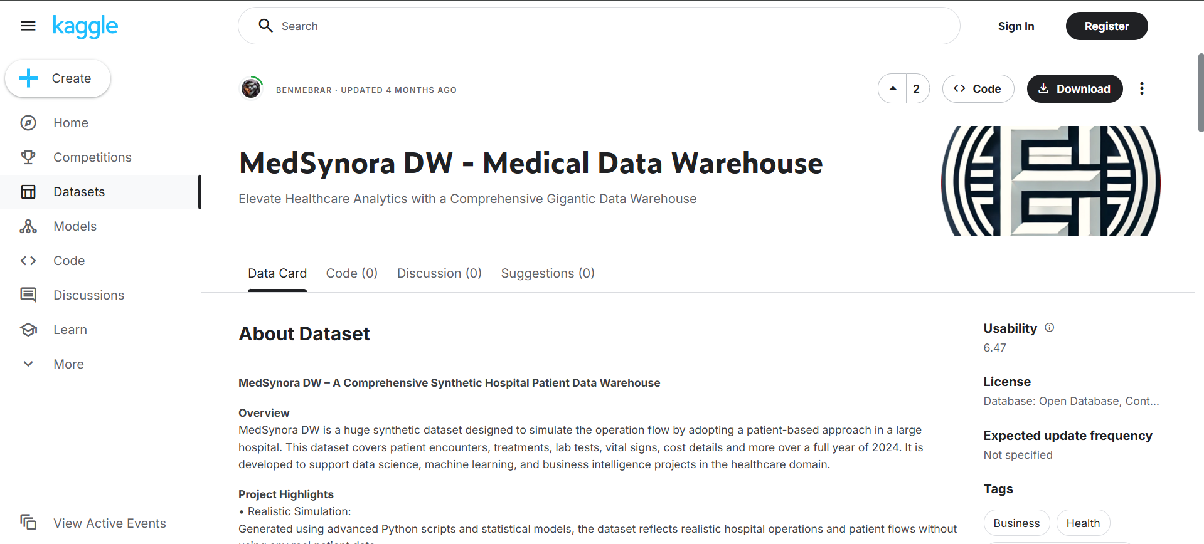
Introduction
MedSynora is a corporate synthetic hospital dataset which includes following data
Patient, Doctor, Encounter, Disease,
Treatment, Lab Tests, Procedures,
Rooms, Cost, Insurance…

Slide 4





Data Sources
DimSpecialTest, DimTreatments
DimDate, DimPatient
DimAllergy, DimChronicDisease
DimAdditionalService, DimDisease
DimDoctor, DimInsurance, DimRoom, Patient_ChronicDisease, BridgeEncounterAdditionalService, Patient_Allergy

Slide 5
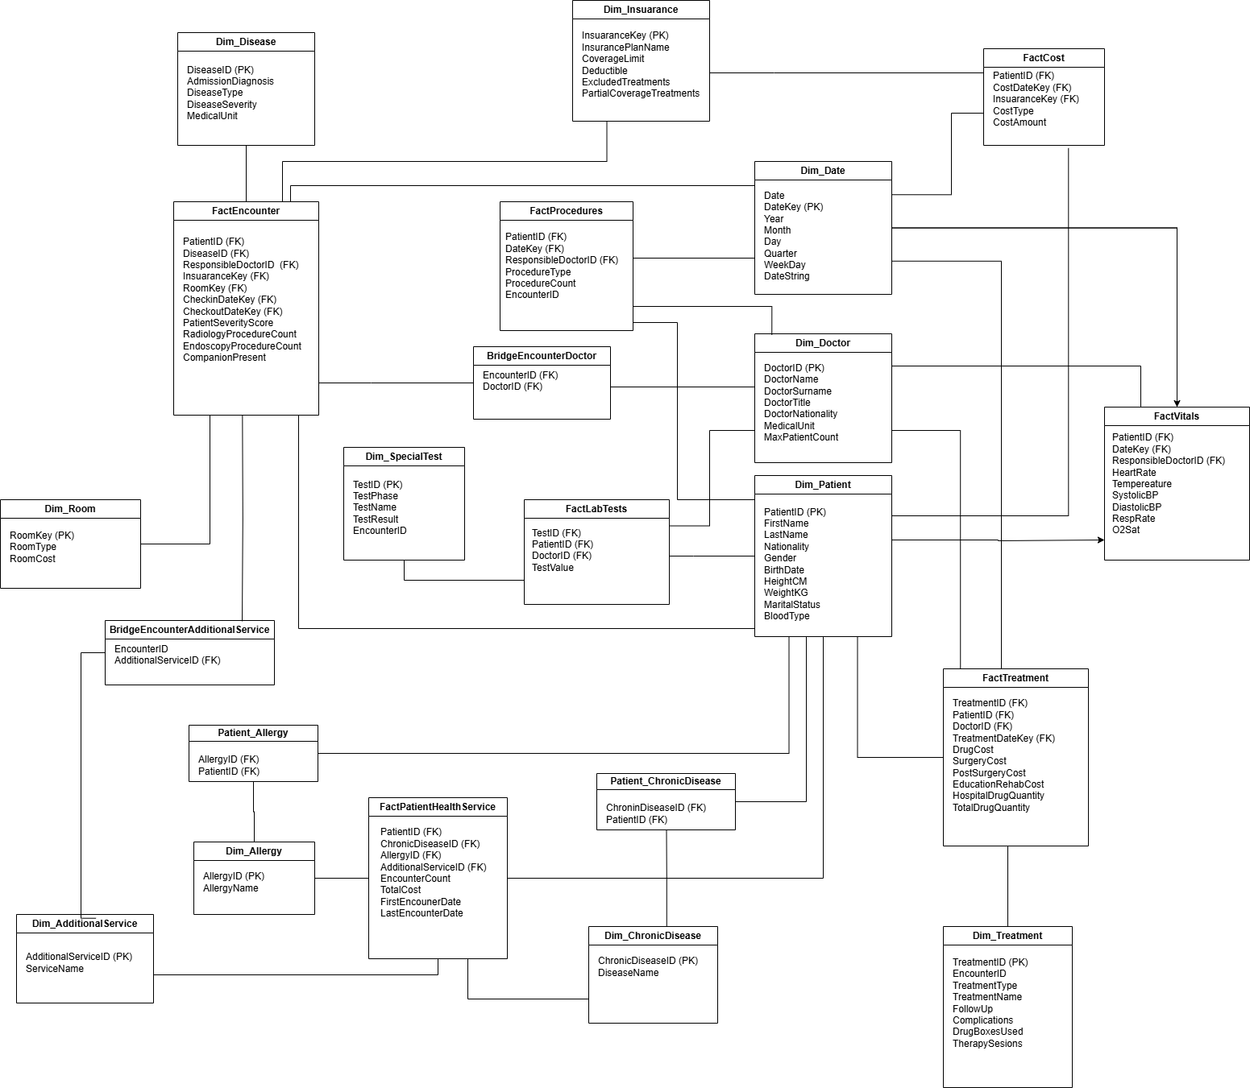
Galaxy Schema

Slide 6
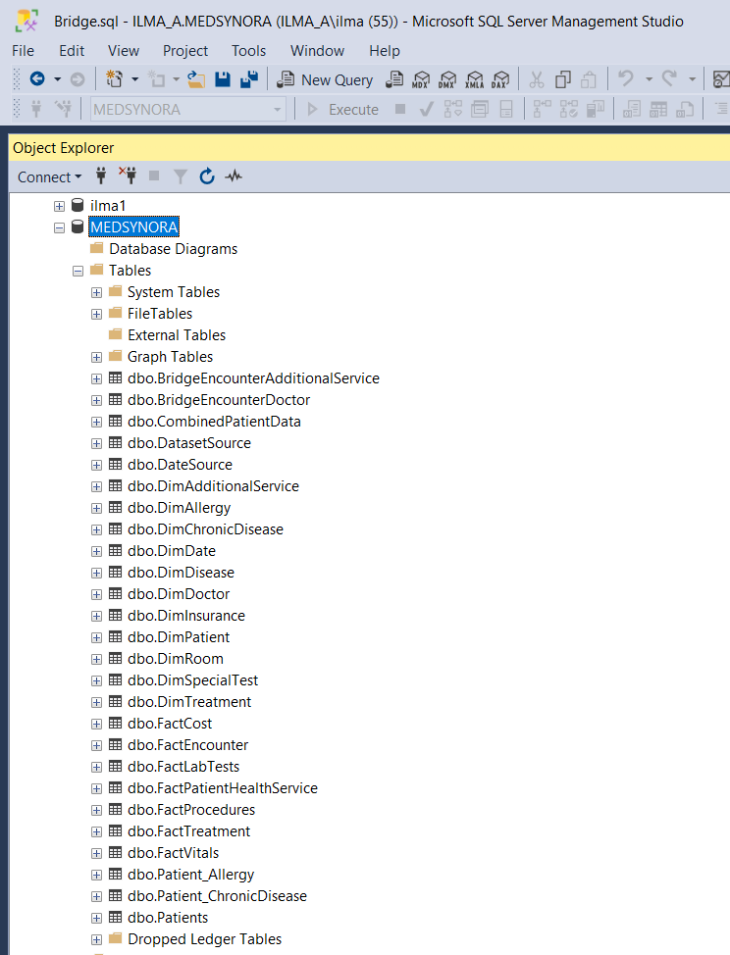
Database Schema
Implemented the Database schema in SQL Server Management Studio
Tables were connected to each other using Primary key and Foreign key Relationships

Slide 7
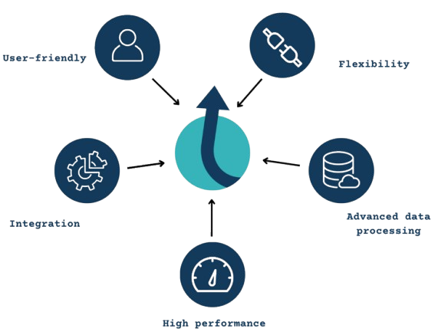
ETL Process
Used Apache Hop as the ETL platform
Will have a look on Pipelines and workflow in Apache hop

Slide 8

Power BI Dashboard
Helps MedSynora turn complex medical and hospital data into clear, interactive dashboards for smarter and faster healthcare management
Will have a look on Power BI dashboard related to MedSynora

Slide 9
Problems and Recommendations
Problems | Recommendations
Recognition of complications | Handling multiple data formats
Invest in chronic disease units | Missing or inconsistent data
Enhance monitoring of costs | Complex joins in bridge tables
Leveraging seasonal patterns to optimize both staffing and inventory | ETL errors - by data types

Slide 10

Conclusion
Implementing a Data Warehouse in MedSynora enables centralized, accurate, and timely access to critical healthcare data, supporting better analysis, reporting, and strategic decision-making.

Slide 11
Thank You
A Project By Group 15

